Slide 1
Mini Project 1
Group 5: Shaan patel, vikram seshadri, pradeep thiagu
Dataset: July 2013-august 2013

Slide 2
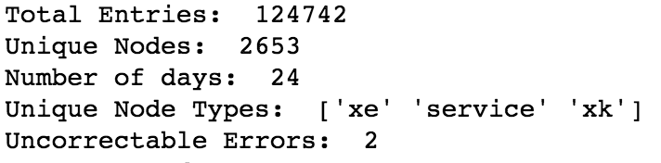
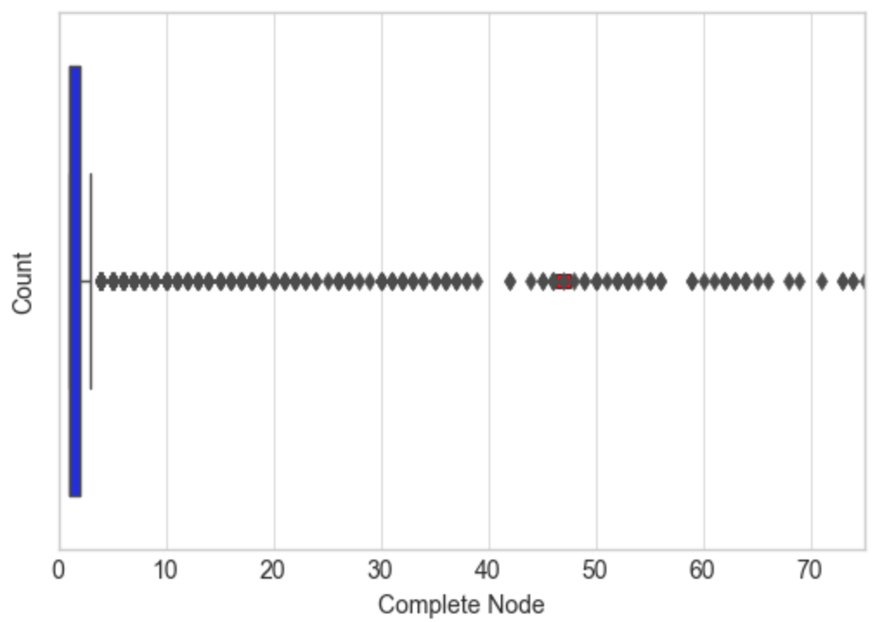
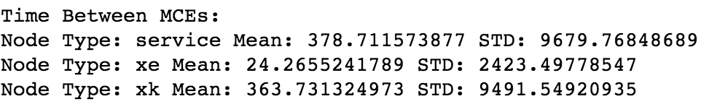
Data Preprocessing & Summary
Combine both datasets and then filter based on time specification. Subsequently, filter out bad data.
Dataset summary
MCE Information with MCE/Node box plot

Slide 3
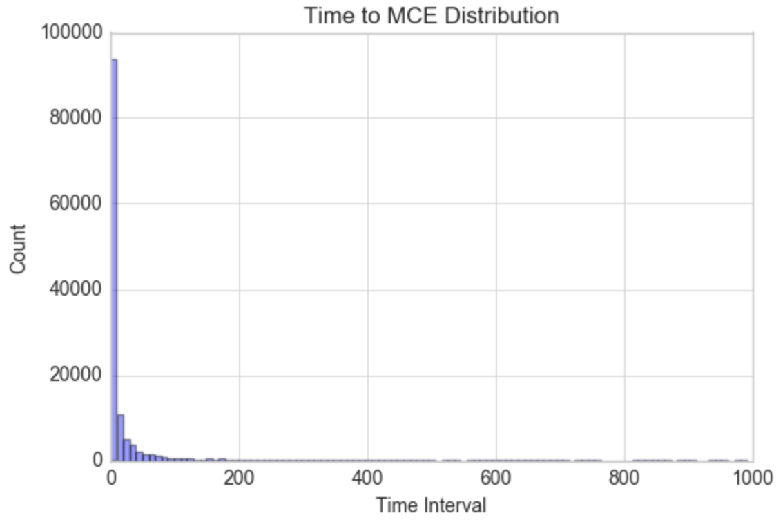
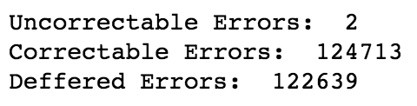
Task 1
Time to MCE Distribution-filtered for times lesser than 1000 sec (31 outliers).
Follows exponential distribution
CE, UC, DEF Errors
TBF = MTBF for Uncorrectable Error
FIT for uncorrectable errors

Slide 4
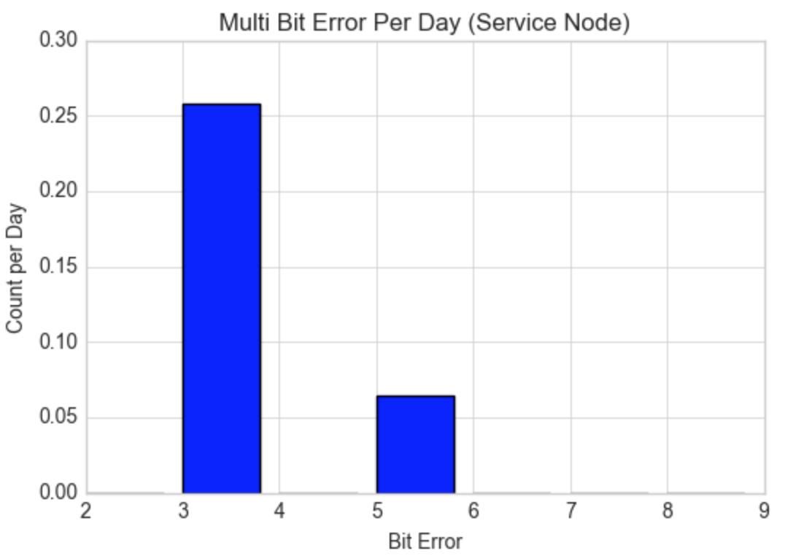
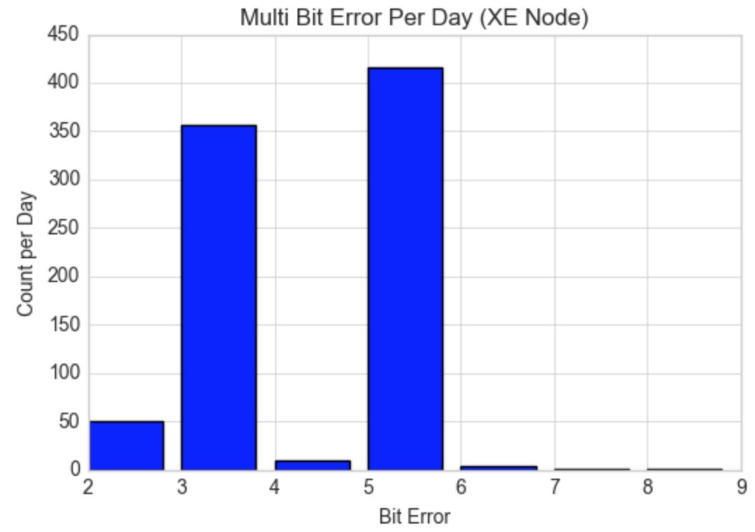
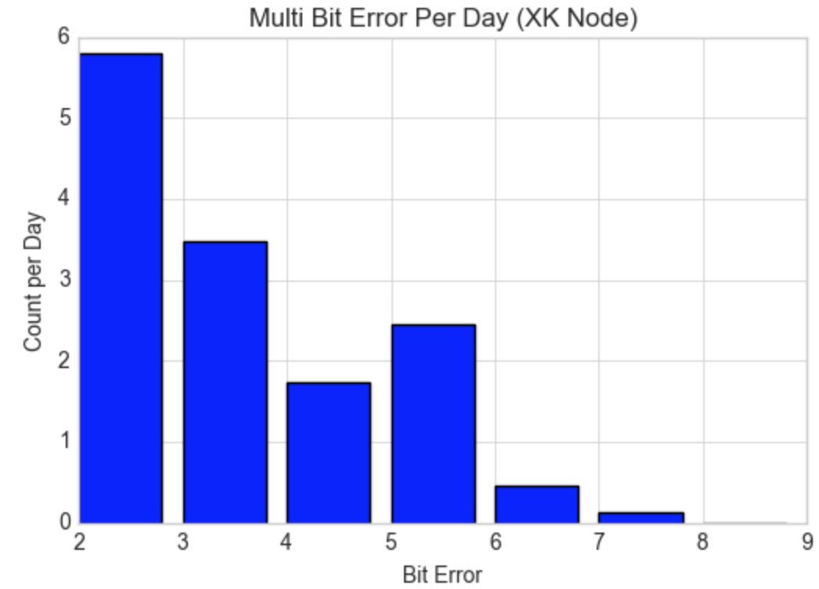
Task 2
Computed breakdown single/multiple bit errors for each node type
Frequency of multiple bit errors for each node type
Hypothesis test
Null Hypothesis: XE nodes perform worse than XK nodes => P(XE) - P(XK) >= 0
Alternative Hypothesis: P(XE) - P(XK) < 0
Significance Level = 0.05; Critical Value = -1.645
P_{XE}: 0.00628033761684116 P_{XK}: 8.417373458819002e-05
Z value: 3.8519658260016754
Since our Z value is greater than -1.645, it supports the alternative hypothesis that XK performs worse than XE

Slide 5
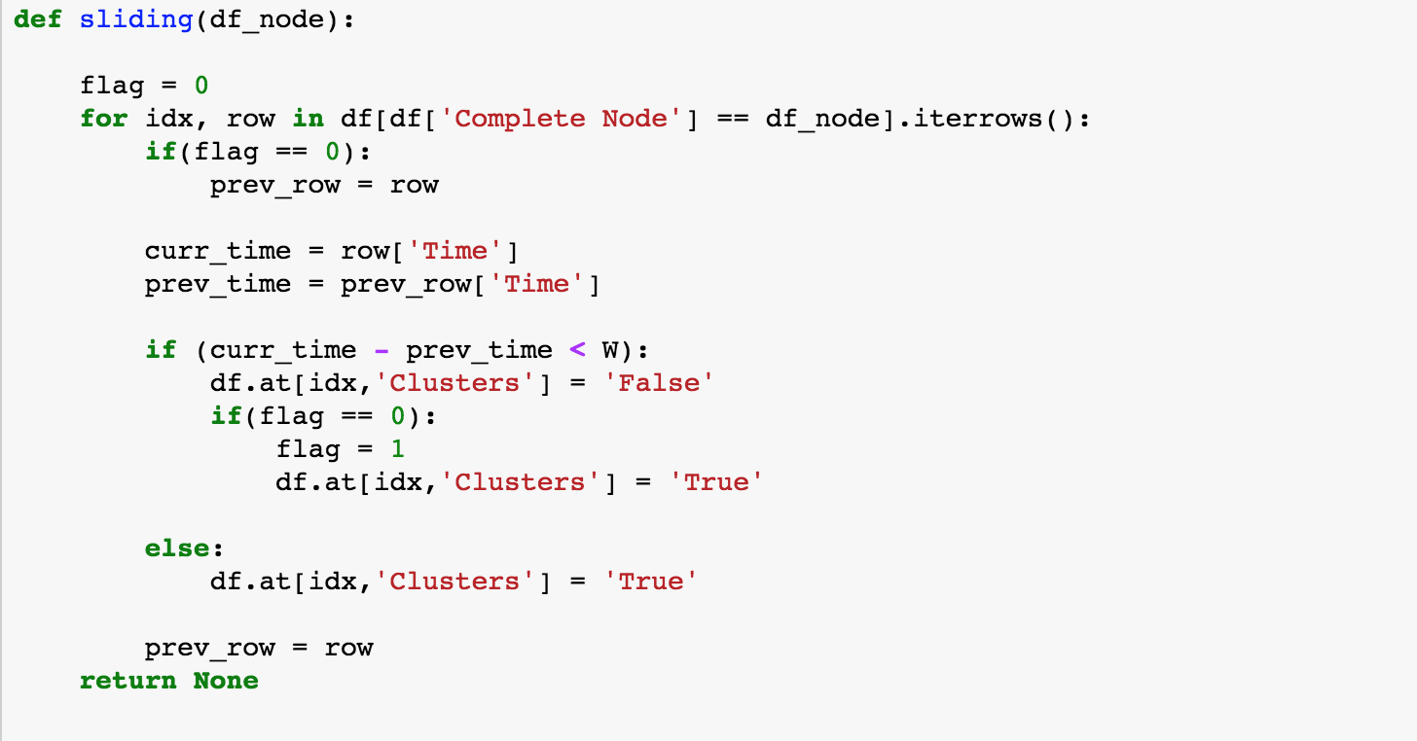
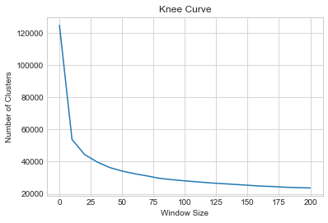
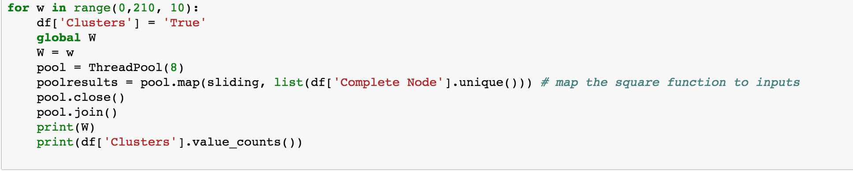
Knee Curve (Window Sizes 0-200)
Data Coalescing
Sliding Window Algorithm
Knee approximately at W=15
Multithreaded Code

Slide 6
Differences After Coalescing
Total entries in dataframe were about halved
Percentage of memory errors down to 29%
Mean time between failure increased to 370 seconds
Memory error and bit error distributions slightly shifted

Slide 7
BAYESIAN NETWORKS
Hypothesis |  | Probability | Decision
H0 | 𝑃 (𝑀𝐶𝐸 = 𝐶| 𝐴𝑝𝑝 = 𝐹𝑎𝑖𝑙𝑒𝑑) | 0.18984
H1 | 𝑃 (𝑀𝐶𝐸 = 𝑃 |𝐴𝑝𝑝 = 𝐹𝑎𝑖𝑙𝑒𝑑) | 0.30146
H2 | 𝑃 (𝑀𝐶𝐸 = 𝑈 |𝐴𝑝𝑝 = 𝐹𝑎𝑖𝑙𝑒𝑑) | 0.50869
H3 | 𝑃( 𝑂𝑆=𝑋 |𝐴𝑝𝑝=𝐹𝑎𝑖𝑙𝑒𝑑) | 0.82058 | H3
H4 | 𝑃 (𝑂𝑆=𝑅 | 𝐴𝑝𝑝=𝐹𝑎𝑖𝑙𝑒𝑑) | 0.17941
MCE | OS | Running | Failed
C | X | 0.0020303 | 0.0199698
P | R | 0.0601128 | 0.0152872
U | R | 0.0001275 | 0.0018724
U | X | 0.0000154 | 0.1460847

Slide 8
Division of Labor
Task 0 – Vikram & Shaan
Task 1 – All
Task 2 – Vikram & Shaan
Task 3 – Vikram & Shaan
Task 4 – Pradeep

